Slide 1
Introduction
to
Human
Anatomy &
Physiology

Slide 2
What is Human
‘Anatomy’?
Human anatomy is the study of the structure and morphology of the parts in the human body.
This means the shape of them and their correct location and orientation.

Slide 3
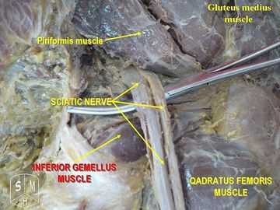
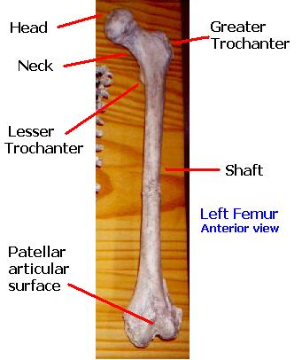
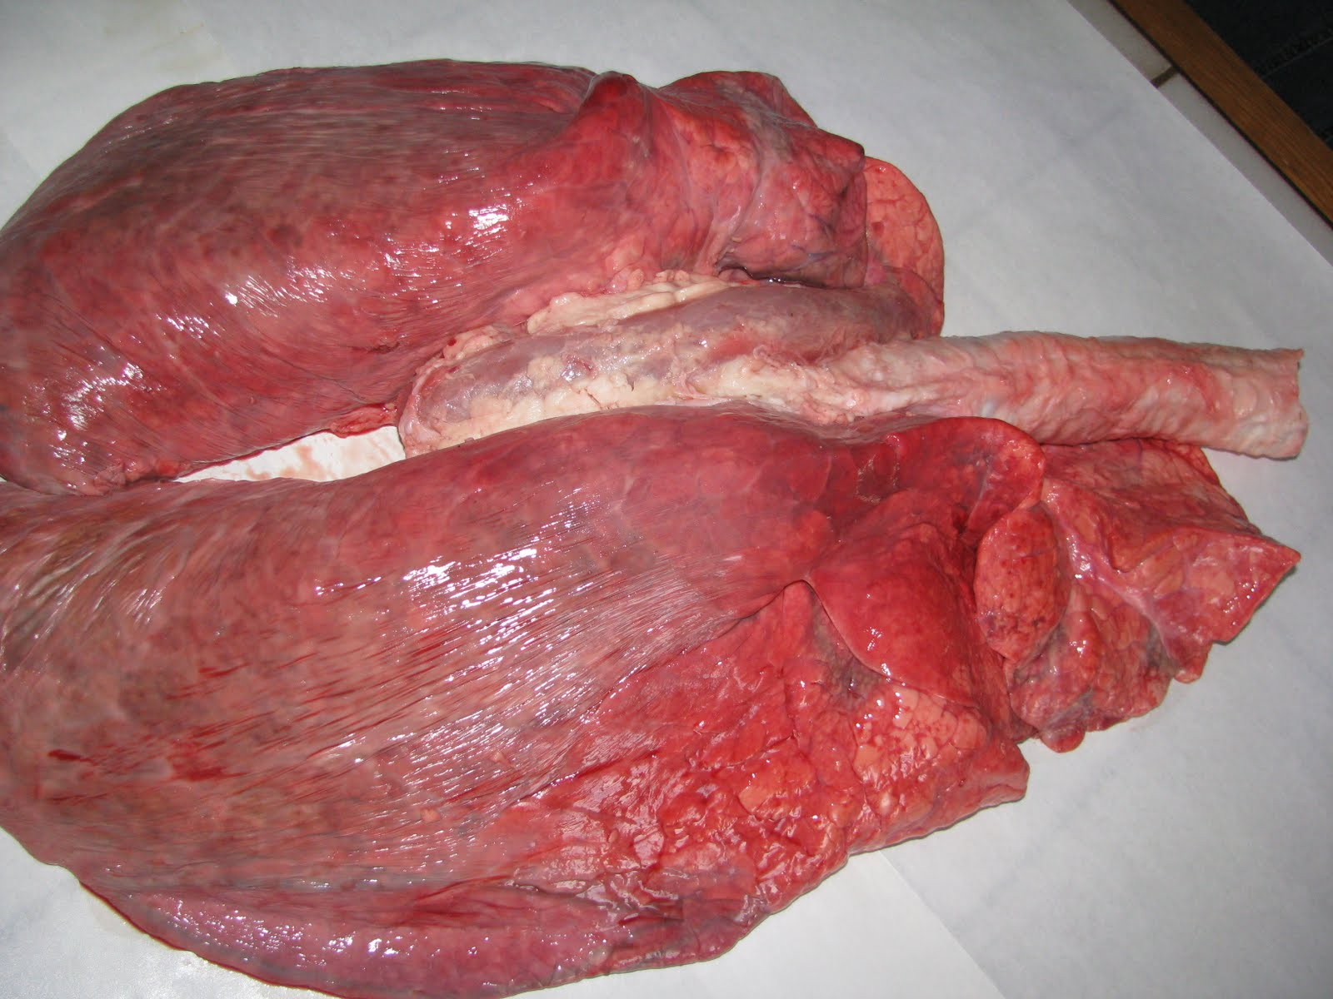
Examples of
Anatomical
Images

Slide 4
What is
Human Physiology?
Human physiology is the study of the functions of these body parts.
For most of us, this will be the difficult part of this course.

Slide 5
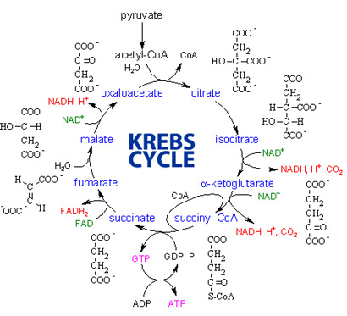
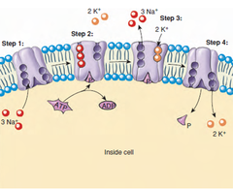
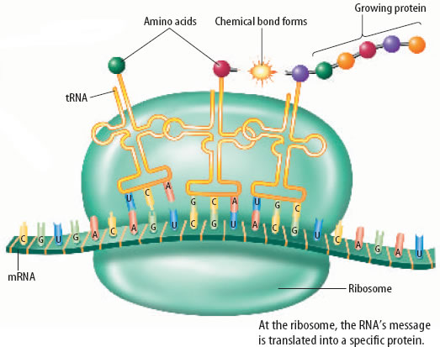
Quick Physiological
Examples

Slide 6
Connecting the anatomy
With the
physiology
Luckily for us, in A&P you will often hear structure and function. These go together nicely most often because the morphology of the part often gives us hints to its function. For example…

Slide 7
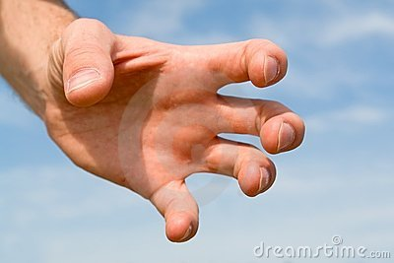
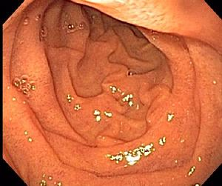
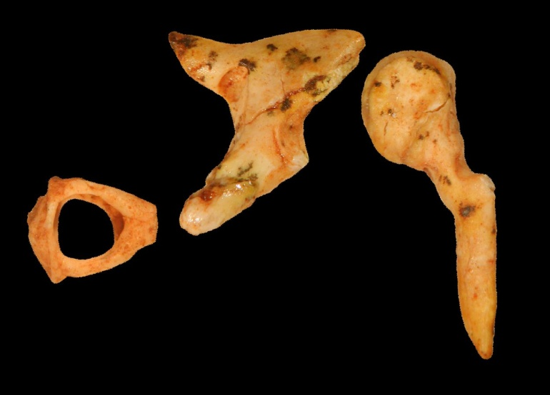
Homework questions…
1-3.
Based on these structures, can you determine the function?
#1: Level Easy.
Write Down the Function.
#2: Level Medium.
Write Down the Function.
#3: Level Hard.
Write Down the Function.

Slide 8
So… in order to be successful:
In anatomy, there is a lot of memorization of diagrams and images and names.
If you memorize well, you should have no problem here.
The tough part is the new language!! In a few slides, you will be presented with homework. It is absolutely a necessary evil!! Sorry!!
Also, we will try as best we can with our current technology and models and assignments to demonstrate visually proper anatomy.

Slide 9
So… In order to be successful:
In Physiology, we need to start with some basic chemistry.
Don’t worry, we’ll attack that nastiness in a week or so, but you will need to have a basic grasp on chemistry. There are a few chemistry words in the upcoming assignment to get us started.
Also, it will require an understanding of a lot of analogies. Since we can’t really see much of what we will learn, you will need to master processes through analogies or diagrams.

Slide 10
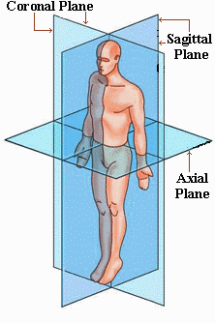
Homework Questions 4-9.
Using the book, label the anatomical planes and give a ‘neat’ definition for each in the box below.
A

Slide 11
Chemical Terms:
Ion
Poly-
Organic
Inorganic
Molecule
Compound
Macromolecule
Salt
Base
Acid
Oxidizing/Oxidizer
Caustic
Atom
Common Anatomical Positioning Terms:
Sagittal
Frontal/Coronal
Transverse/Horizontal
Posterior
Dorsal
Ventral
Anterior
Superior
Inferior
Medial
Lateral
Contralateral
Ipsilateral
Intermediate
Proximal
Distal
Superficial
Deep
Basic Biological Terms:
Organelle
Cell
Tissue
Organ
Organ System
Organism
Common “Studies” Terms:
Histology
Pathology
Gross Anatomy
Physiology
Neurophysiology
Kinesiology
Biochemistry
Biology
Anatomy
Psychology
Cardiology
B
C
A
B

Slide 12
Common Prefixes and Suffixes:
A- co- homeo- mito- sarco-
Ab- com-, con- hydro- -morph- -stasis
Acou- cysto- hyper- myo- sub-
Ad- cyto- hypo- narco- super/supra-
Adipo- de- -ia neo- supra-
-algia derm- idio- nephro- sym-/syn-
Ambi-,amphi- dis- infra- oculo- tachy-
An- dys- inter- neuro- therm-
Andro- ecto- intra- -oma -tomy
Angio- -ectomy -ism -op-/opthalm- -troph-
-ase -emia iso- osteo- vaso-
Auto- entero- -it is oto- vene-
Cardio- -ferous leuko- pan- vivi-
Neuro- gastro- lipo- para- xeno-
Brady- -gen -logy -pathy --------
Brevi- glyco- -lysis -penia
Cephal- -gram macro- peri-
-cele -graph micro- -phobia
Cere-,cerebro- hem- mal- -pneumo
Chondri- hep-,hepato- meso- pseudo-
-cide hist- meta- reno-
D
E
E
C
D

Slide 13
Define the terms, suffixes, or prefixes…
You will be assessed on the following dates:
Group A – August 22
Group B – August 23
Group C – August 24
Group D – August 28
Group E – August 29
On each subsequent day, I will choose 5 words from the previous list for assessment.
I will also collect that groups note cards for that day as a small grade.

